Slide 1
Welcome!!

Slide 2
Monitoring Applications
Prometheus and Grafana
Lunch and learn – 17/12/2018

Slide 3
Agenda
What means monitoring?
01
Short description of what means to monitor applications
Prometheus and Grafana
02
Why using Prometheus and Grafana? What are the main features
Hands on session
03
Install Kafka, prometheus, grafana.
Start producing and consuming messages
Start monitoring the infrastructure
Your turn
04
Create your own dashboard for the Sprig boot applications and get sense of it

Slide 4
Agenda Style
Definition
Dictionary (Collins)
Monitoring
(ˈmɒnɪtərɪŋ)
Noun
1. The act of being a monitor of something
Information about the illness, the medication, monitoring of health, etc is required.
The machine is to be used for heart monitoring.
2. Mechanical engineering the act of observing or recording an engine or other device or its activity or performance
Remote monitoring of jet engines while the planes are in flight
3. The act of checking a radio or television broadcast or its technical quality
The independent monitoring of ABC broadcasts
Definition

Slide 5
What means monitoring for us
IT Environment
Context matter
Functions
Availability
Capacity
Delivery
Monitoring has different signification/sense regarding the context:
Hospital,
Chemical industry
Nuclear Industry
Bank industry
...
And for who is the monitoring:
Patient
CEO
Developer
System manager
Quality manager
...
What are the accessible functions?
Can I trust the data?
Is my application up and running?
What is the version in Prod?
Does I have enough capacity?
What is the current performance?
How team is performing? What is the delivery pace?
Business
Developer
Devops
OS Admin
Scrum master

Slide 6
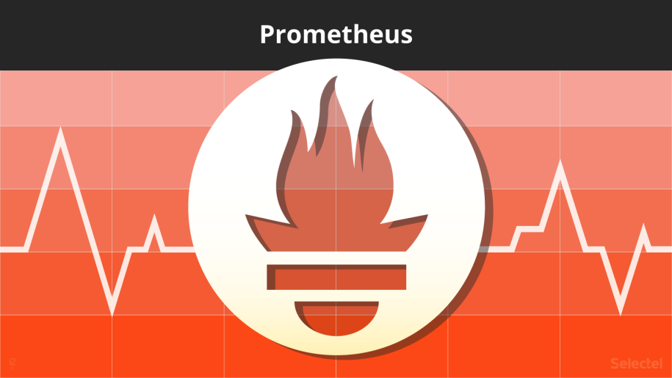
Prometheus
Definitions
What is prometheus
Database
Prometheus is open source monitoring solution since 2015
It is a time-series datasources
Created by
Dimentional Data
It has been developed by SoundCloud in 2012
Time series are composed by name and list of key-value
Cloud Native
Language
It is member of the CNCF (Cloud Native Foundation) It fits well in the cloud native Infrastructure
It includes a query language called PromQL

Slide 7

Agenda Style
Principle
Prometheus gets data using the http endpoints
Application
HTTP
Prometheus
System
HTTP
Other sources
HTTP
The endpoints can be native or custom exporters

Slide 8
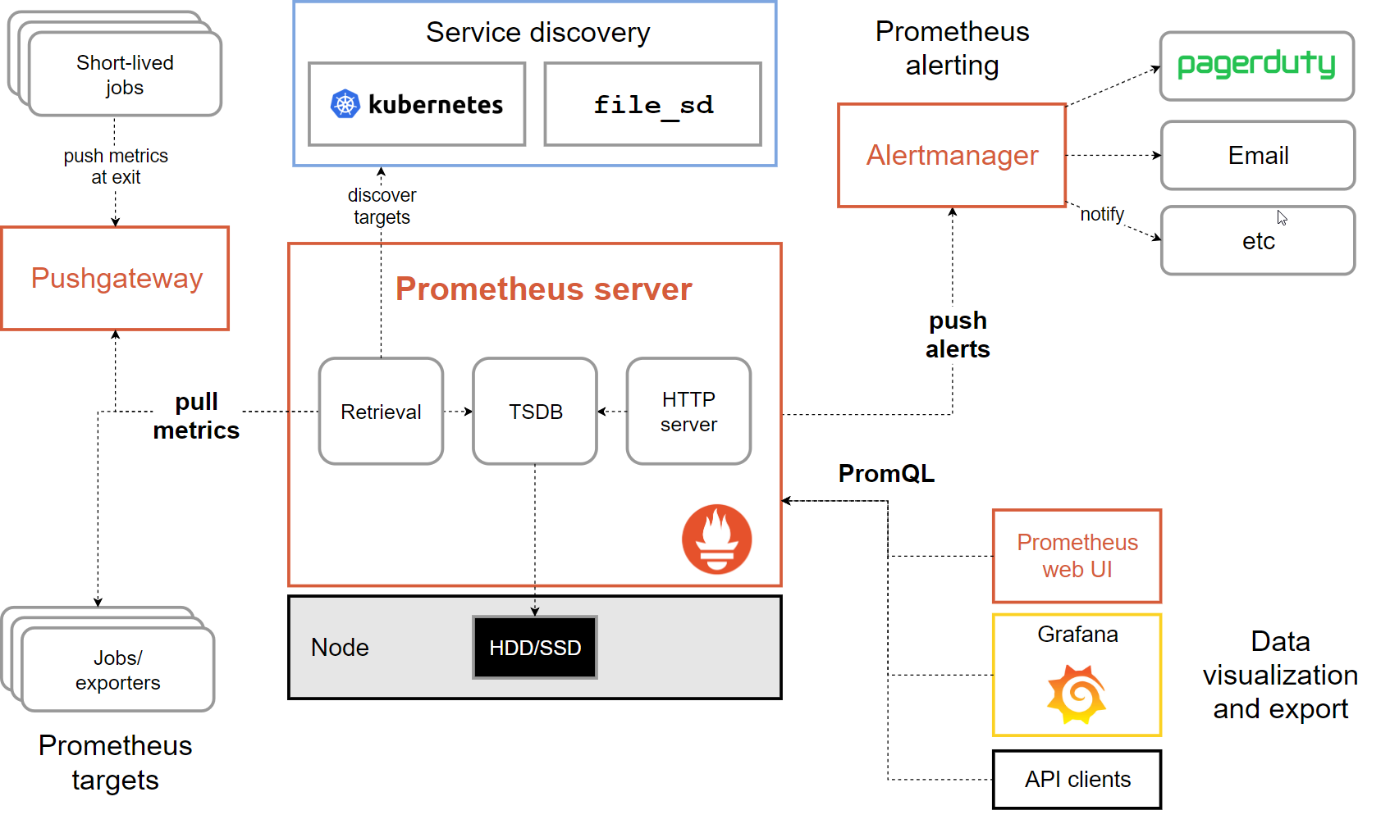
Agenda Style
Typical Architecture
Prometheus

Slide 9
Agenda Style
Exporter
Definition
Expose metrics via http
Prometheus
Existing exporters
https://prometheus.io/docs/instrumenting/exporters/
During this presenation, we will use only:
Jmx Exporter
WMI Exporter

Slide 10
Agenda Style
Core metrics types
Gauge
A gauge is a metric that represents a single numerical value that can arbitrarily go up and down. For example, the number of active connections.
Prometheus
Counter
A cumulative metric that represents a single numerical value that only ever goes up. There is a counter example in the code above.
Histogram
A histogram samples observations (usually things like request durations or response sizes) and counts them in configurable buckets. It also provides a sum of all observed values. Most commonplace metrics fall under this category.

Slide 11
Agenda Style
Core metrics types
Summary
Similar to a histogram, a summary samples observations (usually things like request durations and response sizes). While it also provides a total count of observations and a sum of all observed values, it calculates configurable quantiles over a sliding time window. A typical example is getting the 95th percentile of requests duration to understand the worst case responsiveness of our system.
Prometheus

Slide 12
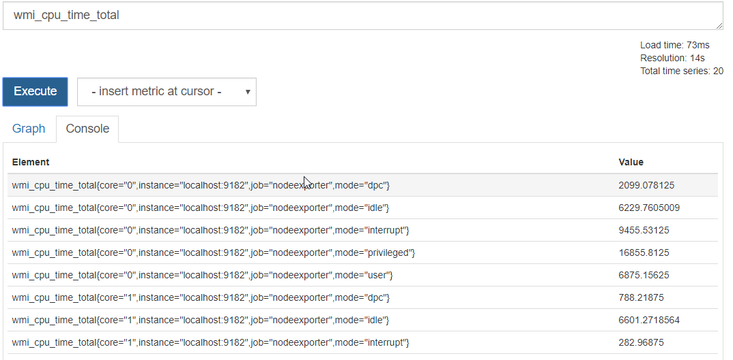
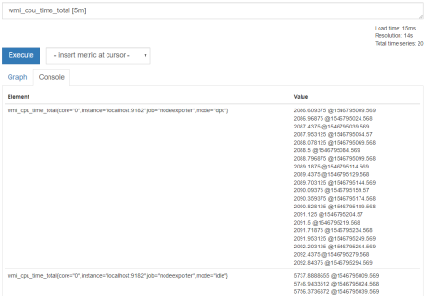
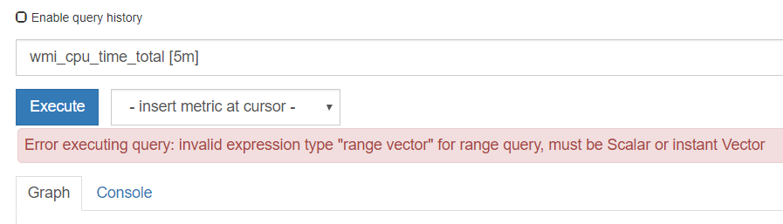
Agenda Style
Quering
Instant Vector
A set of time series containing a single sample for each time series, all sharing the same timestamp
Prometheus
Range Vector
A set o time series containing a range of data point over time for each time series
Scalar
A simple numeric floating point value
String
A simple string value

Slide 13
Agenda Style
Quering
Arithmetic operators
Comparison operators
Logical/set operators
-, +, *, /, %, ^ (exp)
==, !=, >, <, >=, <=
And, or, unless
Aggregation operators
Prometheus
Sum: Sum over dimentions, Min: minimum over dimensions, Max: maximum over dimensions, Avg: average over dimensions, Stddev: standard deviation, Stdvar: population standard deviation, Count: number of element in the vector, Count_values: count elements with the same value, Bottomk: smallest k elements by sample value, Topk: largest k elements by sample value, Quantile: calculate quantile of the value (0<x<1)
Vector matching
Vectors operations attempt to find a matching element in the right-hand side vector for each entry in the left-hand side. There are two basic types of matching behaviour: One-to-one and many-to-one/one-to-many

Slide 14
Agenda Style
Quering
Instant vector selectors
=: Select labels that are exactly equal to the provided string, !=: Select labels that are not equal to the provided string, =~: Select labels that regex-match the provided string (or substring), !~: Select labels that do not regex-match the provided string (or substring).
Prometheus
Range Vector Selectors
s - seconds, m - minutes, h - hours, d - days, w - weeks, y - years
Offset
The offset modifier allows changing the time offset for individual instant and range vectors in a query

Slide 15
Agenda Style
Quering
Functions
abs(), absent(), ceil(), changes(), clamp_max(), clamp_min(), day_of_month(), day_of_week(), days_in_month(), delta(), deriv(), exp(), floor(), histogram_quantile(), holt_winters(), hour(), idelta(), increase(), irate(), label_join(), label_replace(), ln(), log2(), log10(), minute(), month(), predict_linear(), rate(), resets(), round(), scalar(), sort(), sort_desc() sqrt(), time(), timestamp(), vector(), year(), <aggregation>_over_time()
https://prometheus.io/docs/prometheus/latest/querying/functions/
Prometheus

Slide 16

Grafana
Definitions
What is grafana
Alert
Grafana allows you to query, visualize, alert on and understand your metrics no matter where they are stored. Create, explore, and share dashboards with your team and foster a data driven culture.
Seamlessly define alerts where it makes sense — while you’re in the data. Define thresholds visually, and get notified via Slack, PagerDuty, and more
Unify
Bring your data together to get better context. Grafana supports dozens of databases, natively. Mix them together in the same Dashboard.
Visualize
rom heatmaps to histograms. Graphs to geomaps. Grafana has a plethora of visualization options to help you understand your data, beautifully.
Extend
Discover hundreds of dashboards and plugins in the official library. Thanks to the passion and momentum of our community, new ones are added every week

Slide 17
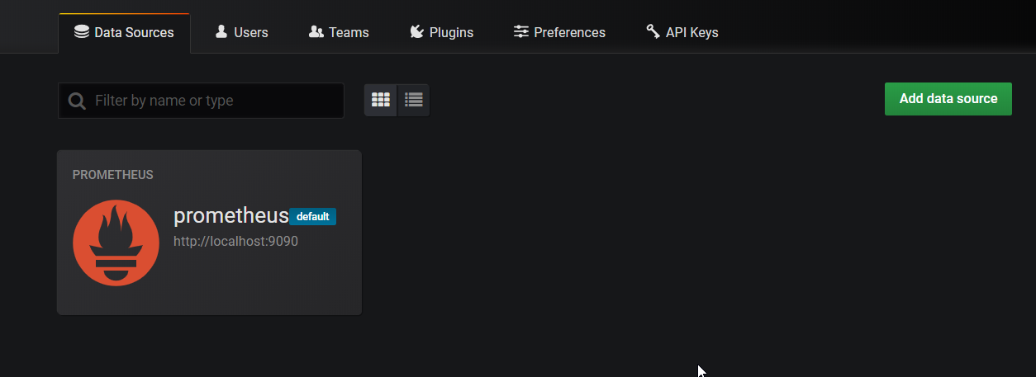
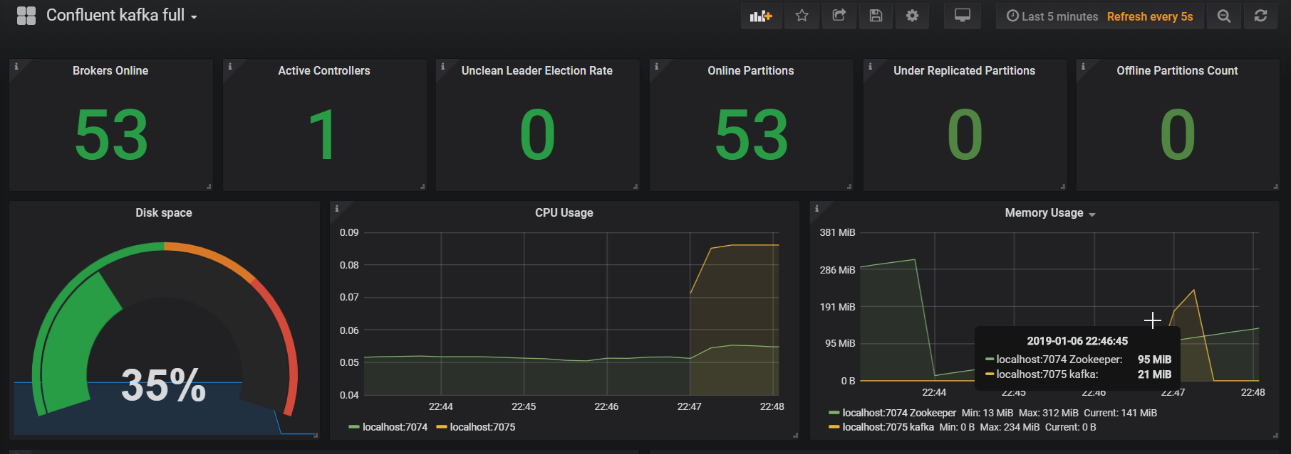
Agenda - Style
Multisource System – Dashboard generation
Grafana

Slide 18
Example
Kafka infra monitoring

Slide 19
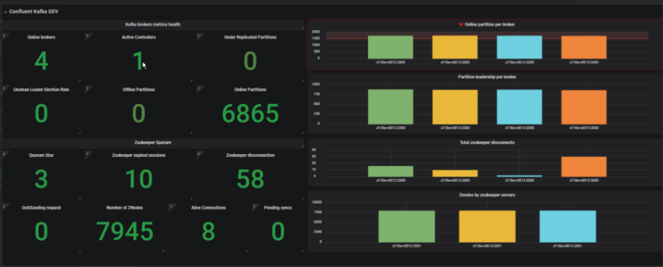
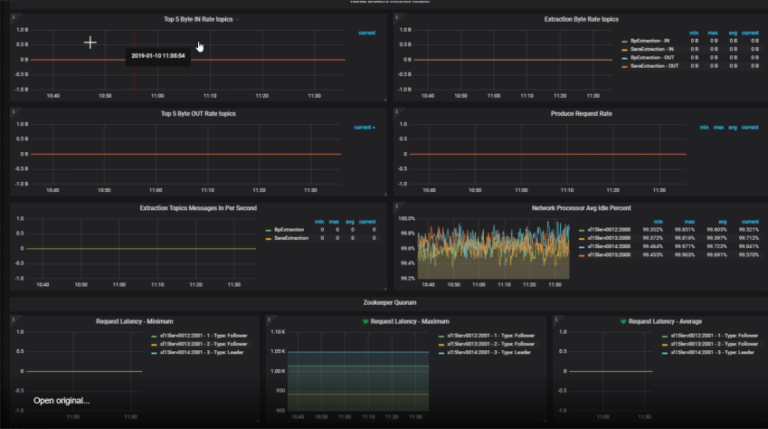
Agenda - Style
Example
Grafana
http:///xl15srv0012:3020

Slide 20
Demo
Hands-on part

Slide 21


Agenda Style
Architecture
Consumer
Human Robot
Shop 1
Spring Boot
H2
DEMO
Producer
Human robot
factory
Spring Boot
Consumer
Micrometer
Human Robot
Shop 2
Spring Boot
H2

Slide 22
Agenda Style
Installation
prerequisite
JDK8 required
kafka confluent installation
unzip the file confluent-5.0.1-2.11-enterprise.zip in your favourite folder
navigate to D:\Boulot\Presentation-monitoring\confluent-5.0.1-2.11-enterprise\confluent-5.0.1\etc\kafka
open server.properties and change
confluent.support.metrics.enable=false
log.dirs=D:/Boulot/Presentation-monitoring/confluent-5.0.1-2.11-enterprise/confluent-5.0.1/kafka-logs
open zookeeper.properties and change
dataDir=D:/Boulot/Presentation-monitoring/confluent-5.0.1-2.11-enterprise/confluent-5.0.1/zookeeper
!! / and not \ !!
DEMO

Slide 23
Agenda Style
Installation
Start Kafka confluent
Start zookeeper:
open a command line
cd D:\Boulot\Presentation-monitoring\confluent-5.0.1-2.11-enterprise\confluent-5.0.1
.\bin\windows\zookeeper-server-start.bat .\etc\kafka\zookeeper.properties
Open a second comand line
cd D:\Boulot\Presentation-monitoring\confluent-5.0.1-2.11-enterprise\confluent-5.0.1
.\bin\windows\kafka-server-start.bat .\etc\kafka\server.properties
DEMO

Slide 24
Agenda Style
Installation
Add prometheus agent to the start
Copy agent.jar and kafka.yml and zookeeper.yml to D:\Boulot\Presentation-monitoring\confluent-5.0.1-2.11-enterprise\confluent-5.0.1
Edit .\bin\windows\kafka-server-start.bat and add set KAFKA_OPTS=-javaagent:.\jmx_prometheus_javaagent-0.3.1.jar=7075:.\kafka.yml
Edit .\bin\windows\zookeeper-server-start.bat and add set KAFKA_OPTS=-javaagent:.\jmx_prometheus_javaagent-0.3.1.jar=7074:.\zookeeper.yml
restart kafka and zookeeper
using chrome go to http://localhost:7075 and http://localhost:7074
!!Great kafka could be monitored....
DEMO

Slide 25
Agenda Style
Installation
Install the node agent
Copy and unzip wmi_exporter-386.zip in your favourite place
cd D:\Boulot\Presentation-monitoring
execute wmi_exporter.exe, it will expose metrics on the http://localhost:9182/
DEMO
Installation prometheus and grafana
unzip the files in your preferred storage and the folder
replace prometheus.yml by the provided one
cd D:\Boulot\Prometheus\prometheus-2.5.0.windows-amd64.tar\prometheus-2.5.0.windows-amd64\prometheus-2.5.0.windows-amd64
Start Prometheus : prometheus.exe
unzip the files in your preferred storage and the folder
cd D:\Boulot\Grafana\grafana-5.3.4.windows-amd64\grafana-5.3.4\bin
Start Grafana: grafana-server.exe

Slide 26
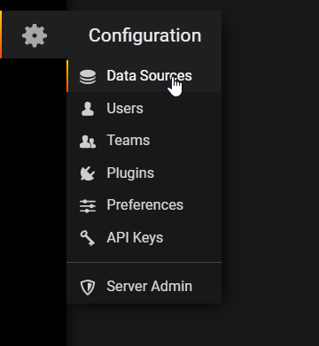
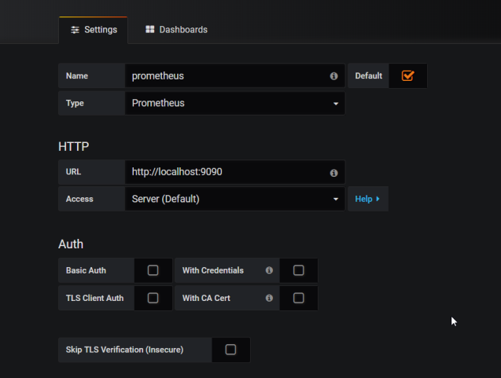
Agenda Style
Monitor Infrastructure
Start monitoring the Infrastructure and Kafka
Start Prometheus
Open the UI: http://localhost:9090
Start Grafana
Open the UI: http://localhost:3000
Add Prometheus as datasource
DEMO

Slide 27
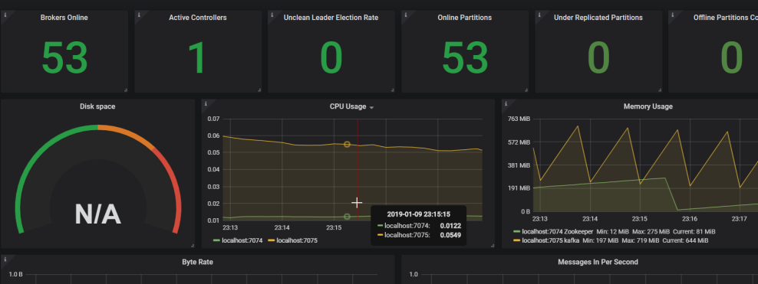
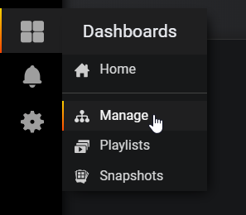
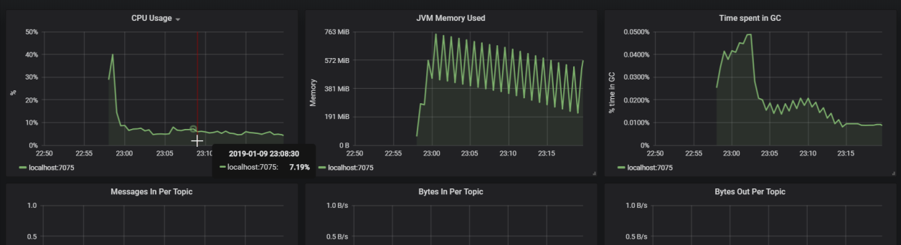
Agenda Style
Monitor Infrastructure
Add dashboard
Add form https://grafana.com/dashboards
Or add directly with the json provided: kafkaBasic.json or KafkaFull.json
DEMO

Slide 28
Agenda Style
Start consumer and producer
Producer
Clone the project or use the provided jar : https://github.com/Ludo-didelot/HumanRobot.git or use the jar HumanRobotInc-0.0.1-SNAPSHOT.jar
Compile and install or package the consumer application and go to the folder “cd D:\Boulot\HumanRobot”
Start Springboot application by adding the jmx agent
java -javaagent:.\src\main\resources\jmx_prometheus_javaagent-0.3.1.jar=7071:.\src\main\resources\config.yaml -jar .\target\HumanRobotInc-0.0.1-SNAPSHOT.jar
DEMO

Slide 29
Agenda Style
Start consumer and producer
Consumer
Clone the project or use the provided jar : https://github.com/Ludo-didelot/HumanRobot-consumer.git or use the jar HumanRobotConsumer-0.0.1-SNAPSHOT.jar
Compile and install or package the consumer application and go to the folder “cd D:\Boulot\HumanRobot”
Start Springboot application by adding the jmx agent
cd D:\Boulot\HumanRobot-consumer
java -javaagent:.\src\main\resources\jmx_prometheus_javaagent-0.3.1.jar=7073:.\src\main\resources\config.yaml -jar .\target\HumanRobotConsumer-0.0.1-SNAPSHOT.jar
DEMO

Slide 30
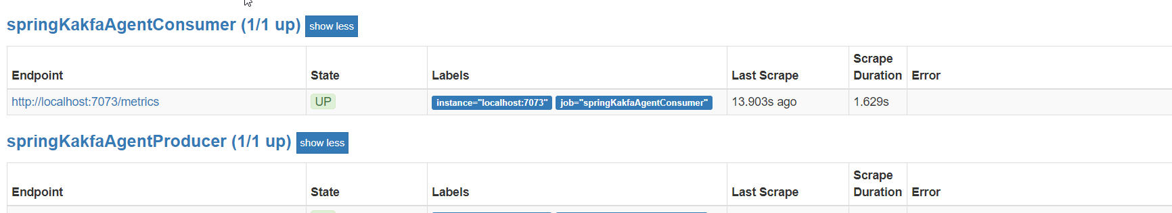
Agenda Style
Verify monitoring
Consumer
Go to the http://localhost:7073/
Producer
DEMO
Go to the http://localhost:7071/

Slide 31
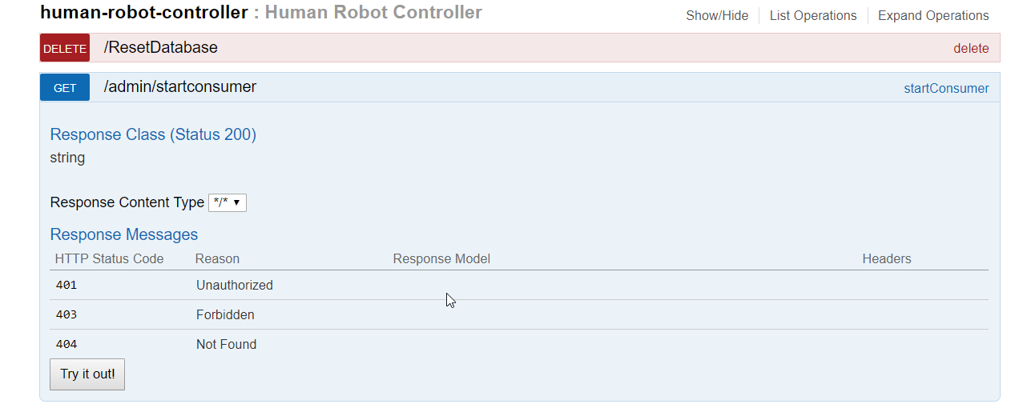
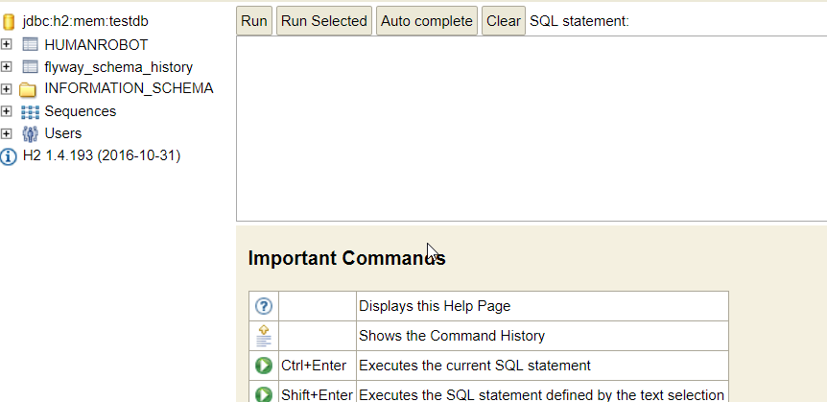
Agenda Style
Start the applications
Consumer
Go to the http://localhost:8083/swagger-ui.html
Click on the admin/startconsumer in the human-robot-controller.
Open the db in http://localhost:8083/h2-console/login.jsp
DEMO

Slide 32
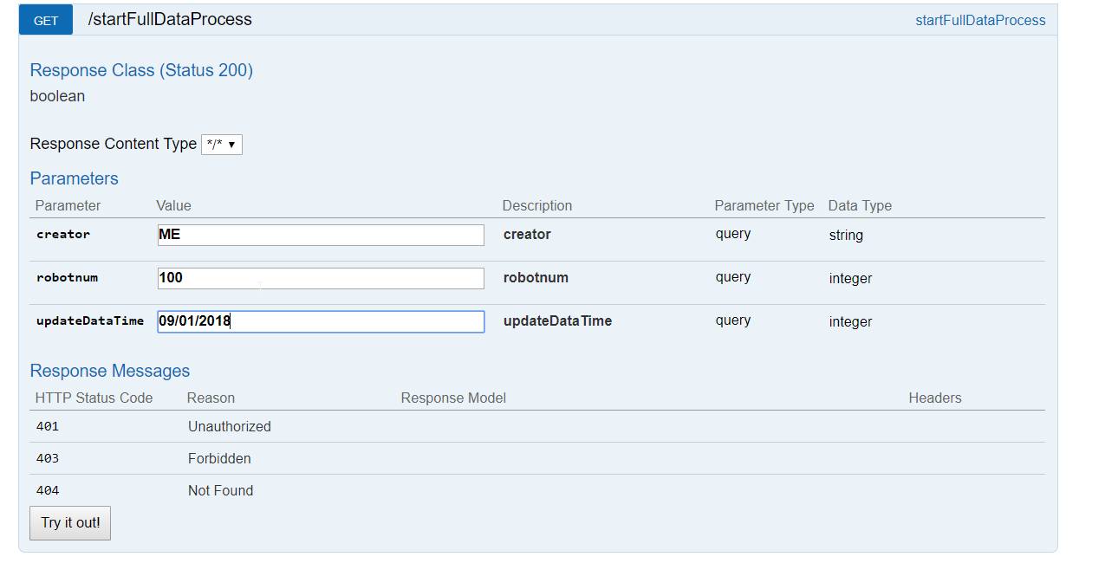
Agenda Style
Start the applications
Producer
Go to the http://localhost:8082/swagger-ui.html
Click on the/startFullDataProcess in the human-robot-controller to start the data creation
Creator: me
robotNum: 100
Updatedate: now
DEMO

Slide 33
Agenda Style
Start a second consumer using micrometer
Add micrometer to the pom.xml
<dependency> <groupId>io.micrometer</groupId> <artifactId>micrometer-spring-legacy</artifactId> <version>1.0.3</version> </dependency> <dependency> <groupId>io.micrometer</groupId> <artifactId>micrometer-registry-prometheus</artifactId> <version>1.0.3</version> </dependency>
Add the bean to catch registry and add a label
@Bean MeterRegistryCustomizer<MeterRegistry> metricsCommonTags() { return registry -> { registry.config().commonTags("application", "Consumer-with-class"); }; }
DEMO

Slide 34
Agenda Style
Start a second consumer using micrometer
Add custom time metrics on the controller
@Timed( value = "get.human.robot.stat", histogram = true, percentiles = {0.95, 0.99}, extraTags = {"mytag", "customhuman"} )
Add counter metrics on usage of the query using the client
String result = "success"; Metrics.counter("search.robot", "result", result).increment();
Start the consumer and look at the monitoring (http://localhost:8084/prometheus)
java -jar .\target\HumanRobotConsumerClass-0.0.1-SNAPSHOT.jar
DEMO

Slide 35
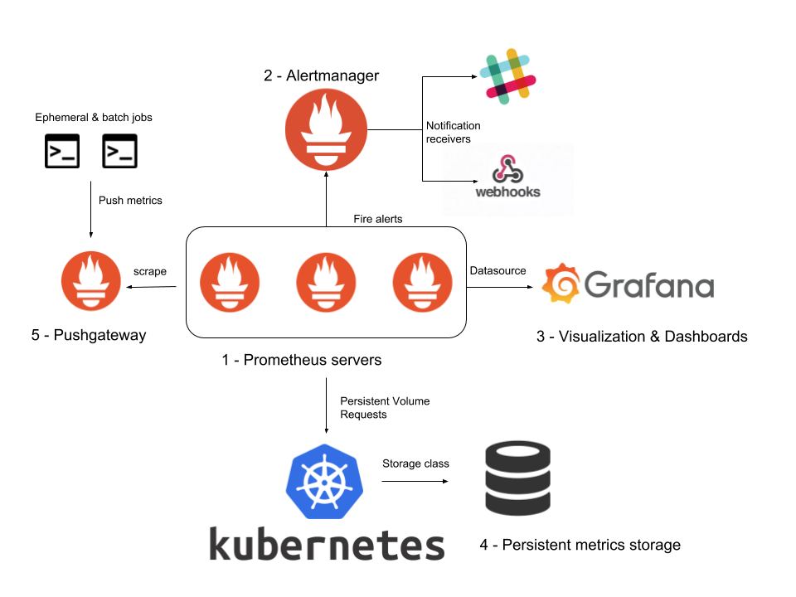
Alert Manager
Definitions
What is Alert Manager
It can silence, inhibit, aggregate and/or send out notifications
Alert Manager is open source alerting module of Prometheus
It manages alerts coming from Prometheus server.
Several channels for alerts propagation such as email, PagerDuty and HipChat.

Slide 36
Agenda Style
Typical Architecture (reminder)
Alert Manager

Slide 37
Agenda Style
Installation and configuartion of alertmanger
Download the module :
https://prometheus.io/download/
( or https://github.com/prometheus/alertmanager )
Extract it
Alert manager configuration
- configuration of the YAML file
Alert manager

Slide 38
Agenda Style
Configuration of prometheus server
1 - Prometheus server configuration
- configuration of the YAML file
# Alertmanager configuration
alerting:
alertmanagers:
- static_configs:
- targets: ['localhost:9093']
# Load rules once and periodically evaluate them according to the global 'evaluation_interval'.
rule_files:
- '../rules/*.yml'
2 - Rules creation (in Prometheus server)
- Create a new folder: rules
- Create YAML file for KAFKA alerts (alert-kafka-broker-rules.yml) in folder rules
Alert manager

Slide 39
Demo
Hands-on part

Slide 40
Agenda Style
Hands-on
Create an Alert when a broker is down
Propagate alert by mail
Silent alert (thought the interface) after 2 send
Propagate alert in Slack
Alert manager

Slide 41
Links
Useful links

Slide 42
Agenda Style
Links
Grafana
https://grafana.com/dashboards
Prometheus
LINKS
https://github.com/prometheus/jmx_exporter
https://promcon.io/2016-berlin/talks/the-prometheus-time-series-database/
https://github.com/google/re2/wiki/Syntax
https://github.com/skalogs/skalogs-bundle/blob/master/templates/prometheus/infra-prometheus-rules.conf
https://prometheus.io/docs/prometheus/latest/configuration/configuration/#<file_sd_config>
https://github.com/skalogs/skalogs-bundle/tree/master/files/prometheus
https://prometheus.io/docs/prometheus/latest/querying
DEMO
https://github.com/Ludo-didelot

Slide 43
Thank you
Insert the title of your subtitle Here

